Slide 1
Deep Learning: RNNs
Recurrent Neural Networks
Notes:
Welcome to the presentation on Deep Learning, specifically focusing on Recurrent Neural Networks. Today, we will explore the fundamentals of RNNs, their architecture, and applications. Ask students if they have any prior knowledge of neural networks.

Slide 2
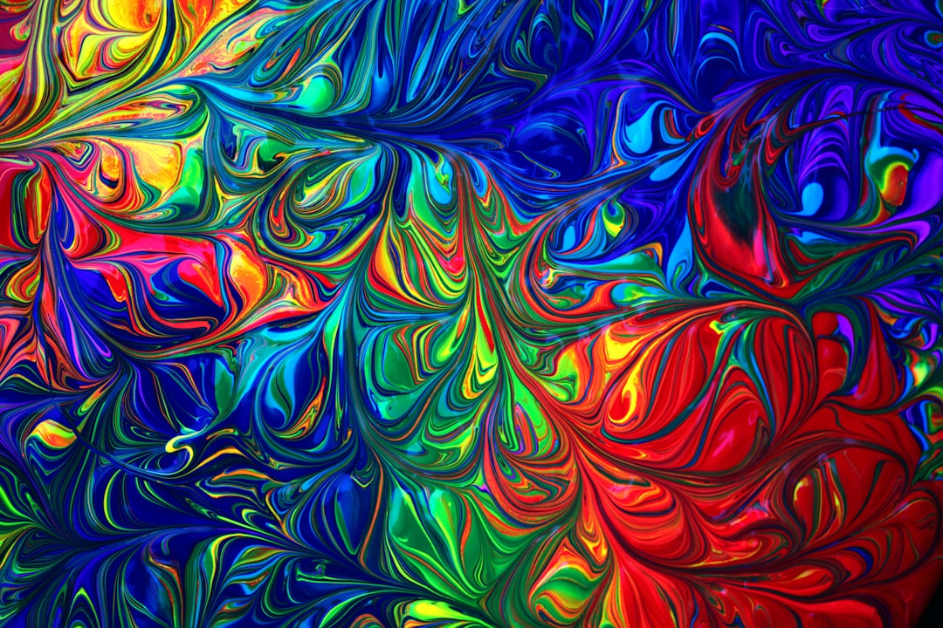
Introduction to RNNs
RNNs handle sequential data
Used for time series forecasting
Applications in natural language processing
Can learn patterns in data
Recurrent connections allow feedback
Trained using backpropagation
Can be used for speech recognition
Also used in machine translation
Effective for sequential data analysis
Key component in many AI systems
Notes:
Explain that RNNs are designed to handle sequential data and are commonly used in applications such as time series forecasting and natural language processing. Provide examples of how RNNs can learn patterns in data and ask students to think about potential applications.

Slide 3
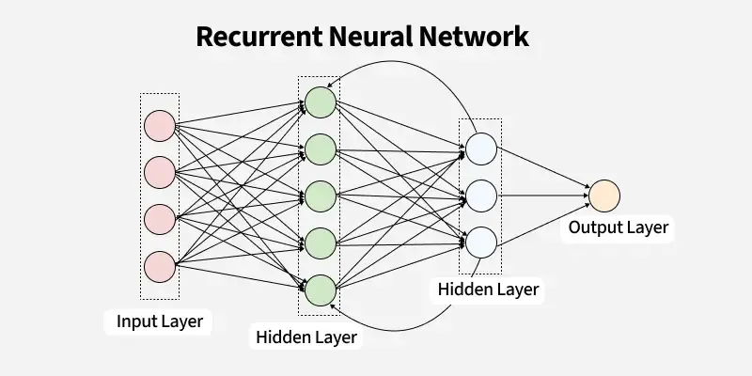
Architecture
Consists of input, hidden, output layers
Recurrent connections in hidden layer
Image_query: RNN architecture diagram
Simple equation: y = sigmoid(x)
Hidden state updated at each time step
Output depends on hidden state
Can be unrolled for analysis
Training involves optimizing weights
Activation functions used in hidden layers
Backpropagation used for training
Notes:
Describe the basic architecture of an RNN, including the input, hidden, and output layers. Explain the role of recurrent connections in the hidden layer and how the hidden state is updated at each time step. Use the image_query to display a diagram of the RNN architecture and ask students to identify the different components.

Slide 4
Variants
LSTM (Long Short-Term Memory) networks
GRU (Gated Recurrent Unit) networks
Bidirectional RNNs for sequential data
Depth-wise separable RNNs for efficiency
Residual connections for deep RNNs
Attention mechanisms for focusing
Recurrent Highway Networks for depth
Clockwork RNNs for periodic data
Neural Turing Machines for memory
Stack-Augmented RNNs for parsing
Notes:
Discuss the different variants of RNNs, including LSTMs and GRUs. Explain how these variants address specific limitations of traditional RNNs, such as vanishing gradients. Ask students to think about which variant might be most suitable for a given application.

Slide 5
Applications + Advantages/Limitations
Speech recognition and synthesis
Natural language processing and translation
Time series forecasting and analysis
Advantage: handles sequential data
Limitation: vanishing gradients
Advantage: learns patterns in data
Limitation: computationally expensive
Used in chatbots and virtual assistants
Used in sentiment analysis and text classification
Effective for sequential data analysis
Notes:
Explain the various applications of RNNs, including speech recognition, natural language processing, and time series forecasting. Discuss the advantages of RNNs, such as their ability to handle sequential data and learn patterns. Also, discuss the limitations, including vanishing gradients and computational expense. Ask students to think about potential applications and how RNNs might be used to address real-world problems.

Slide 6
Summary
RNNs handle sequential data
Consists of input, hidden, output layers
LSTM (Long Short-Term Memory) networks
Speech recognition and synthesis
Notes:
Summarize the key takeaways from the presentation, including the basics of RNNs, their architecture, and applications. Emphasize the importance of RNNs in deep learning and their potential for addressing complex problems. Ask students to reflect on what they have learned and how they might apply RNNs in their own projects or research.

